Slide 1
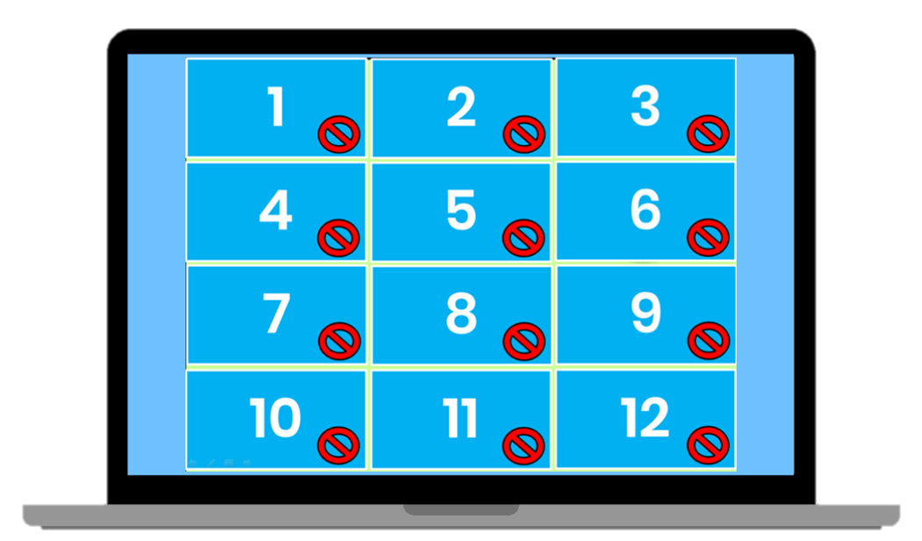
Matching Game
How to Play
Divide the class into two teams. Each team then takes turns in choosing TWO squares. If the two squares are the same word , then the team gets a point. If the two squares are different, then click on the red circle to hide the picture again. Students must try to remember where the matching pairs of words are.
YOU MAY EDIT (1-14 items / boxes by your choice of pairing words etc, good for a 7-item test)
www.Games4esl.com

Slide 2
Matching Game
LESSON: DAYS OF THE WEEK
There are 7 days in 1 week: Monday, Tuesday, Wednesday, Thursday, Friday, Saturday and Sunday.
Match the correct numbers with the same corresponding day.

Slide 3
Friday | Monday
Friday | Saturday
Tuesday | Thursday
Wednesday | Saturday
Monday | Sunday
Thursday | Tuesday
Wednesday | Sunday
1
2
3
4
5
6
7
8
9
10
11
12
13
14

